Slide 1


Slide 2


Zed Attack Proxy (ZAP) is a free, open-source penetration testing tool being maintained under the umbrella of the Open Web Application Security Project (OWASP).
ZAP is designed specifically for testing web applications and is both flexible and extensible.
At its core, ZAP is what is known as a “man-in-the-middle proxy.”

Slide 3
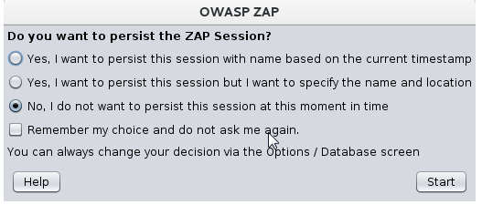
Installations Steps for ZAP
Step 1:
Download the appropriate installer from the https://www.zaproxy.org/download/ page.
Step 2:
Once the installation is complete, launch ZAP and read the license terms. Click Agree if you accept the terms, and ZAP will finish installing, then ZAP will automatically start.
Step 3:
When you first start ZAP,

Slide 4
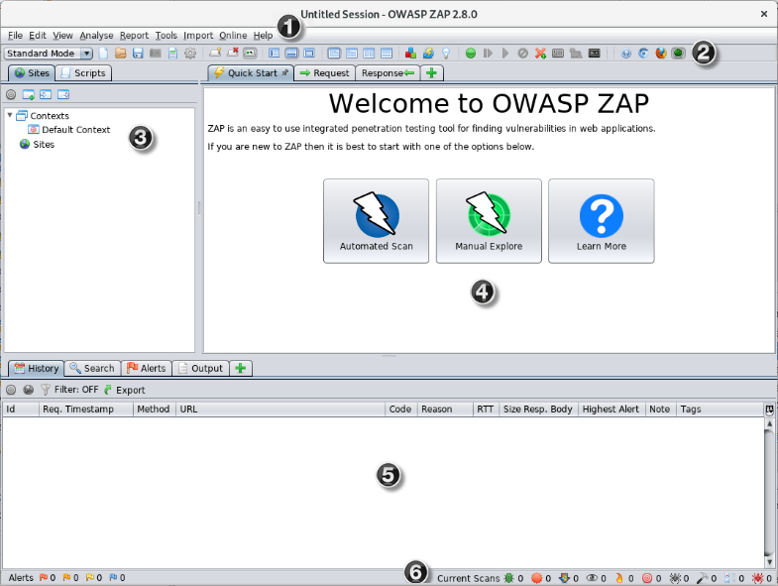
Step 4:
ZAP Desktop UI will open
1.Menu Bar – Provides access to many of the automated and manual tools.
2.Toolbar – Includes buttons which provide easy access to most commonly used features.
3.Tree Window – Displays the Sites tree and the Scripts tree
4.Workspace Window – Displays requests, responses, and scripts and allows you to edit them.
5.Information Window – Displays details of the automated and manual tools.
6.Footer – Displays a summary of the alerts found and the status of the main automated tools.

Slide 5
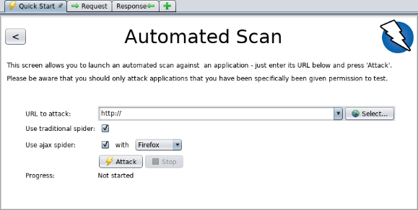
Step 5:
To run a Quick Start Automated Scan :
Start ZAP and click the Quick Start tab of the Workspace Window.
Click the large Automated Scan button.
In the URL to attack text box, enter the full URL of the web application you want to attack.
Click the Attack

Slide 6
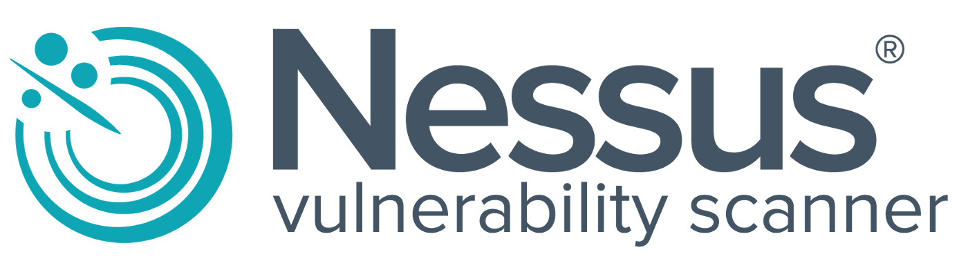

Slide 7
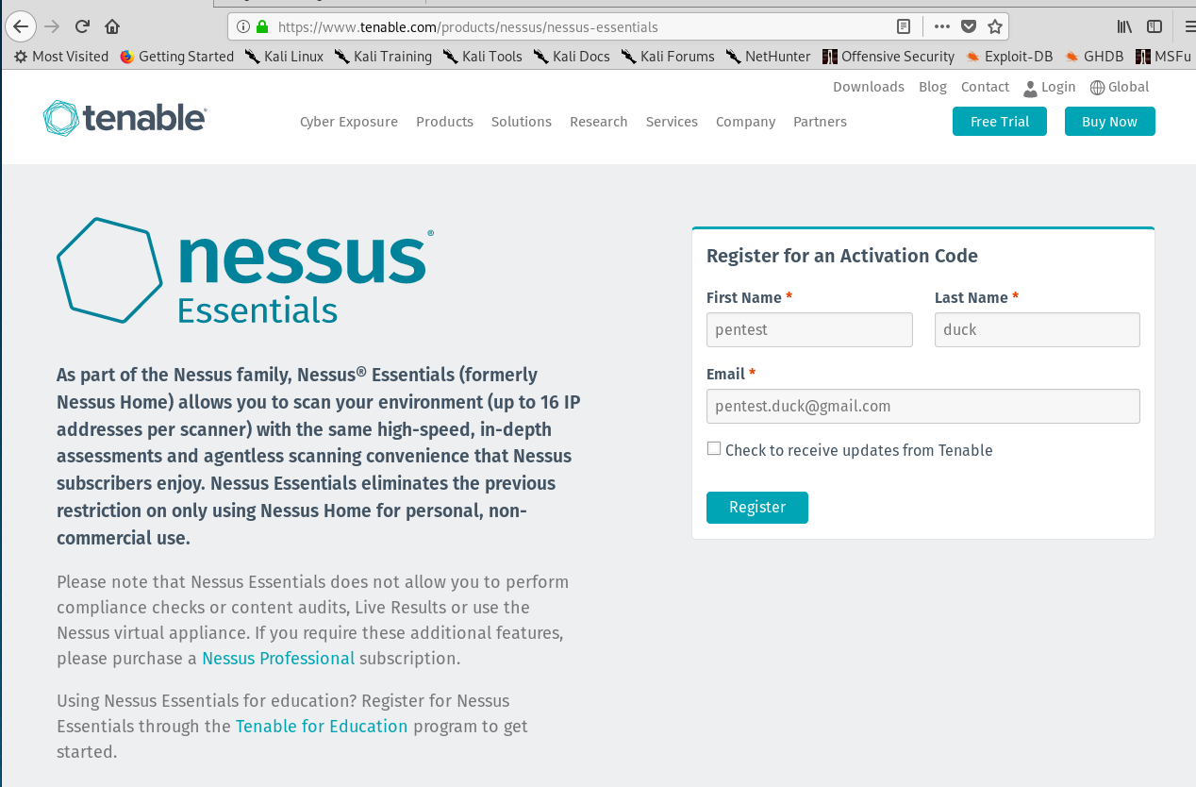
Nessus is a remote security scanning tool, which scans a computer and raises an alert if it discovers any vulnerabilities that malicious hackers could use to gain access to any computer you have connected to a network.
Nessus is a paid, commercial vulnerability assessment tool
The free version of Nessus, called Nessus Essentials (formerly called Nessus Home)

Slide 8

Quick Installation Guide
Step1:Browse to https://www.tenable.com/products/nessus/nessus-essentials and enter your First Name, Last Name and Email address to register for an activation code.

Slide 9
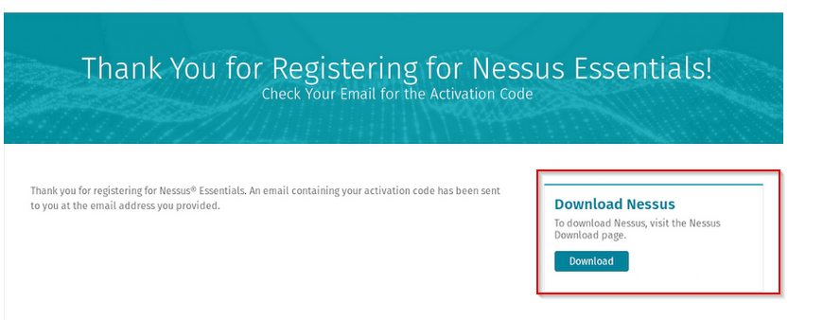
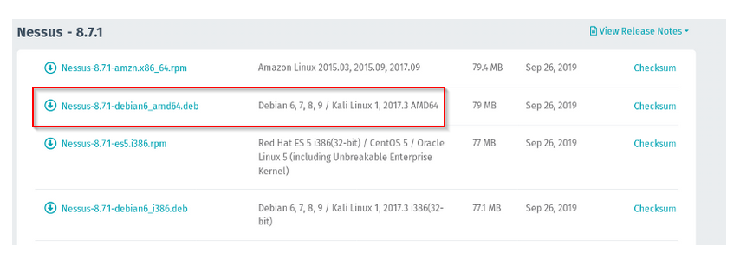
Step2: On the next page, press the “Download” button, and choose the appropriate version for your OS: - Kali Linux 64-bit: Nessus-8.7.1-debian6_amd64.deb, - Kali Linux 32-bit: Nessus-8.7.1-debian6_i386.deb, etc..

Slide 10
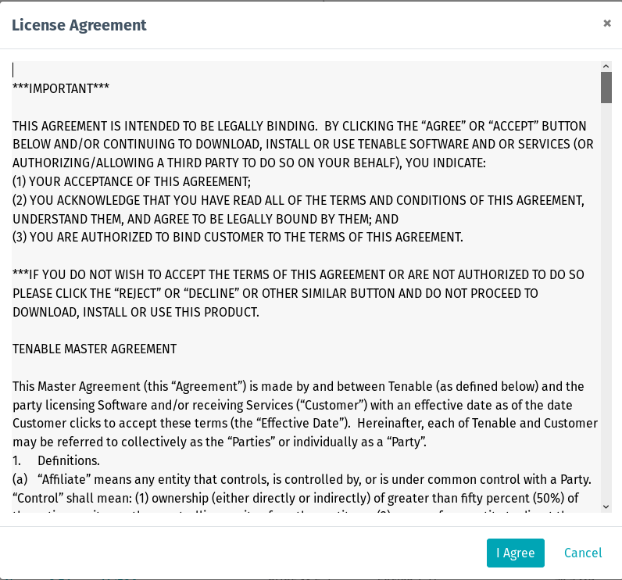
Step3: Press “I Agree” to the license agreement and let Nessus download (you can press “Save” on the popup that appears just before the download). Hang tight, as your machine needs to download around 75 MB.

Slide 11
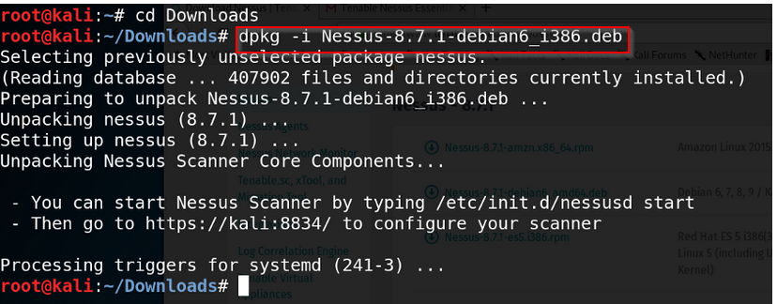
Step4: In Terminal, go to the Downloads directory (cd Downloads) and unpack Nessus (dpkg -i Nessus-version-OS_architecture.deb). In my case, I ran dpkg -i Nessus-8.7.1-debian6_i386.deb.
Step 5:Start the Nessus daemon with service nessusd start or /etc/init.d/nessusd start. (You can optionally let Linux start the Nessus daemon at boot time with update-rc.d nessusd enable)

Slide 12
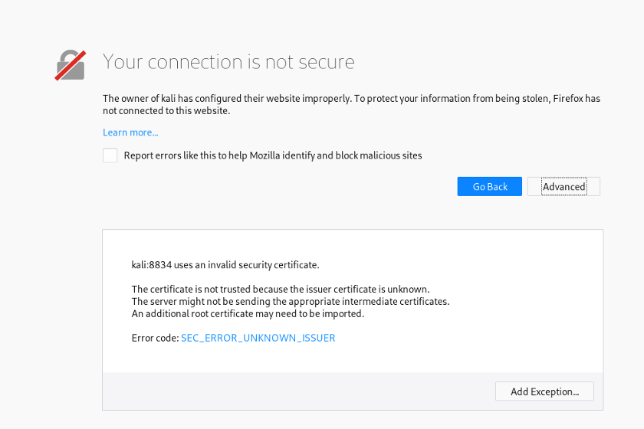
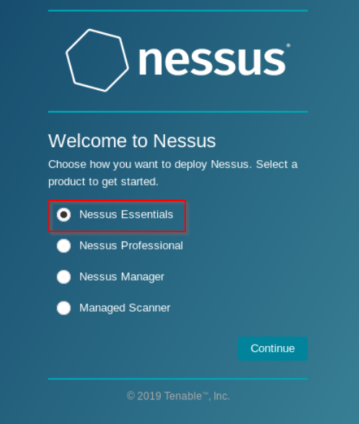
Step6: Browse to the Nessus GUI at https://kali:8834/ and you should get a security error. Click Advanced > Add Exception > Confirm Security Exception to allow Nessus.
Step7: Select Nessus Essentials and press Continue.

Slide 13
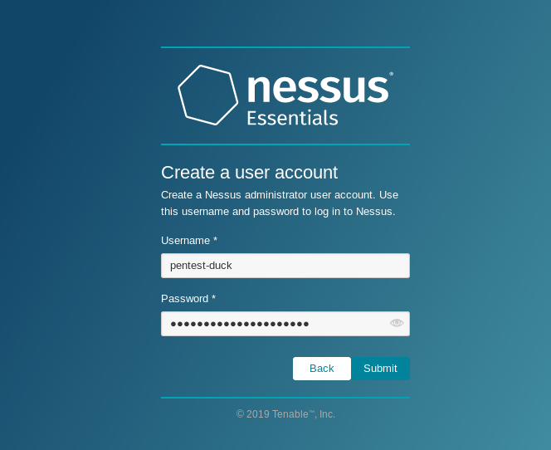
Step8: When you get a screen that asks for you to enter in your First and Last Name and Email address, just click Skip as you have already registered for an activation code.
Step 9. Go to your email inbox, and you should have received an email from Tenable containing your activation code. Copy this, and paste it into Nessus, and click Continue.
Step 10. Create a user account by entering in a username and password and click Submit. You will use this account to log into Nessus every time.

Slide 14
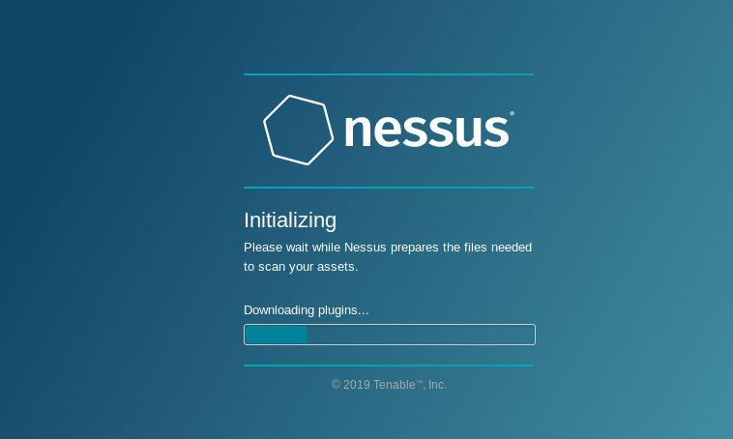
Step 11: Wait for Nessus to finish the installation (will usually take around 45 to 60 minutes)!

Slide 15

QualysGuard is the Qualys Cloud Platform. Overview – Qualys IT, Security and Compliance apps are natively integrated, each sharing the same scan data for a single source of truth.
What types of devices does Qualys analyze during a scan?
Qualys assesses the security risk of all networked, IP devices. This includes all routers, switches, hubs, firewalls, servers (all common operating systems), workstations, desktop computers, printers, and wireless access devices.
How many different types of vulnerabilities do you detect?
Qualys scans for more than 20,000 vulnerabilities across hundreds of applications and operating systems.

Slide 16
What happens after Qualys detects a vulnerability? Do you provide information to help me correct the problem?
Host Information: IP address, hostname & Fully Qualified Domain Name (where available), operating system, and asset group(s).
Vulnerability Information: vulnerability severity, description of the threat posed by the vulnerability, recommendation for correcting the problem (including links to vendor sites), and the result, if available, which shows how Qualys verified the vulnerability.

Slide 17
THANK YOU

